Slide 1
Midterm project
Karim Gumar and Token Bayurzhan

Slide 2
1.Mobile adapting
To make website mobile adaptable we use this meta:
Therefore,we use “width:100%” to make images responsive.
Another popular CSS framework is Bootstrap. Bootstrap uses HTML, CSS and jQuery to make responsive web pages.

Slide 3

2.Defining colors by rgb,rgba,hexadecimal numbers,etc.
Here is one of the methods rgba:
Colors are very important to give a good look and feel to your website. HTML colors are specified with predefined color names, or with RGB, HEX, HSL, RGBA, or HSLA values.

Slide 4
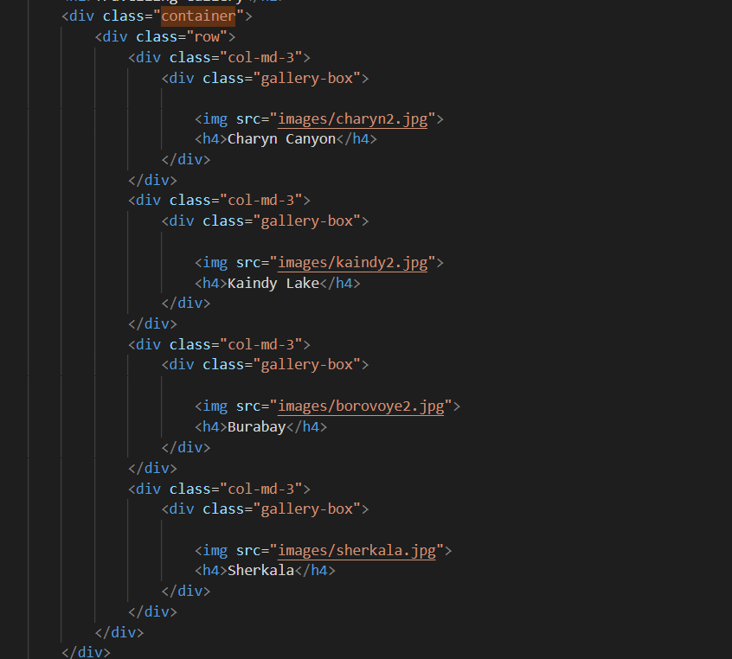
3.Bootstrap grid system
The Bootstrap Grid System is used for layout, specifically Responsive Layouts. The Grid is made up of groupings of Rows & Columns inside 1 or more Containers. The Bootstrap Grid can be used alone, without the Bootstrap JavaScript and other CSS Components.

Slide 5

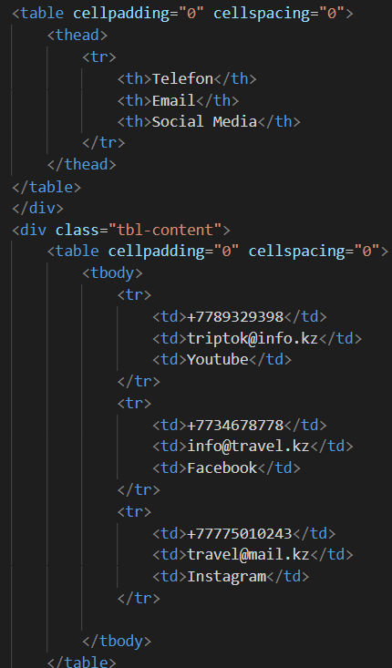
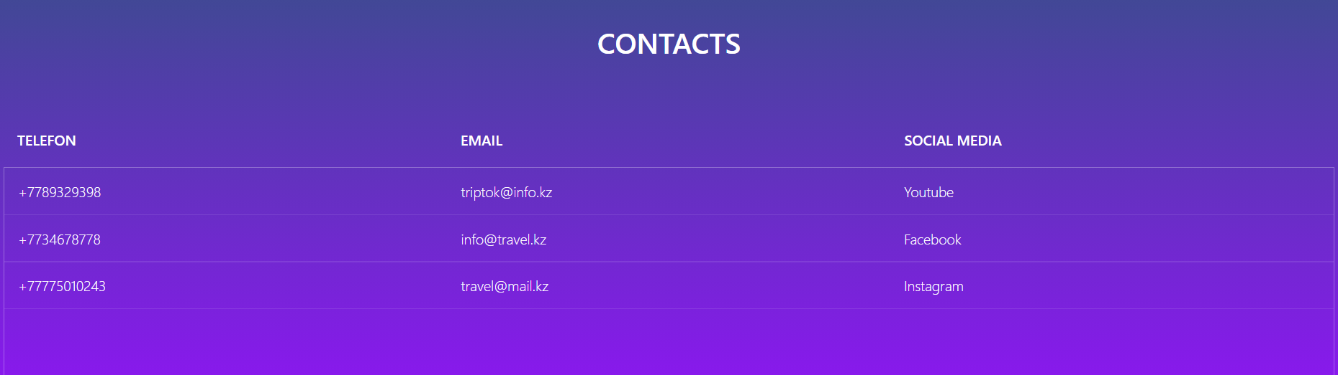
4.Button And table
Here is an example how to write button:
And example of table:

Slide 6
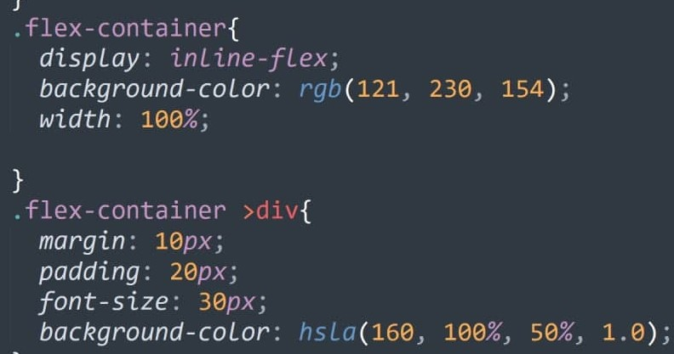
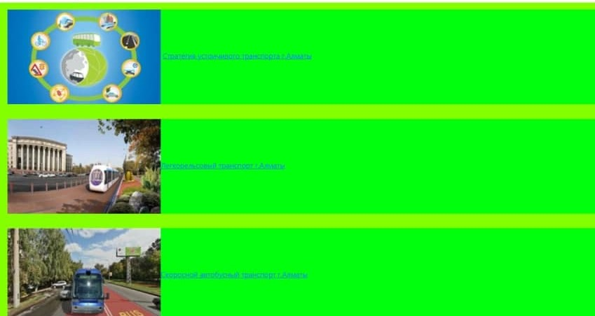
5.Flexbox containers
We use flexbox is because we want to lay a collection of items out in one direction or another. As you lay out your items you want to control the dimensions of the items in that one dimension, or control the spacing between items.

